Slide 1

An Analysis on the Effect of Bank Customers on Generated Revenue
STAT311-50
Fall 2024
Authors: SJ Zimmermann
Ian Wallin

Slide 2
Data Overview
Our data was provided by a bank wanting to gain insight on how different customers contribute to the bank’s revenue. Data was collected on 7,420 customers. The data provided was broken down into the follow variables:
Rev_Total - Total revenue generated by the customer over a 6-month period.
Bal_Total - Total of all account balances, across all accounts held by the customer
Offer - An indicator of whether the customer has received a special promotional offer in the previous one-month period. Offer=1 if the offer was received, Offer=0 if it was not.
AGE - The customer’s age
CHQ - Indicator of debit card account activity. CHQ=0 is low (or zero) account activity, CHQ=1 is greater account activity.
CARD - Indicator of credit card account activity. CARD=0 is low or zero account activity, CARD=1 is greater account activity
SAV1 - Indicator of primary savings account activity. SAV1=0 is low or zero account activity, SAV1=1 is greater activity
LOAN - Indicator of personal loan account activity. LOAN=0 is low or zero account activity, LOAN=1 is greater activity
MORT - Indicator of mortgage account tier. MORT=0 is lower tier and less important to the bank’s portfolio. MORT=1 is higher tier and indicates the account is more important to the bank’s portfolio
INSUR - Indicator of insurance account activity. INSUR=0 is low or zero account activity, INSUR=1 is greater activity
PENS - Indicator or retirement savings (pension) account tier. PENS=0 is lower balance and less important to bank’s portfolio. PENS=1 is higher tier and of more importance to the bank’s portfolio
Check - Indicator of checking account activity. Check=0 is low or zero account activity, Check=1 is greater activity
CD - Indicator of certificate of deposit account tier. CD=0 is lower tier and of less importance to the bank’s portfolio. CD=1 is higher tier and of more importance to the bank’s portfolio
MM - Indicator of money market account activity. MM=0 is low or zero account activity, MM=1 is greater activity
Savings - Indicator of savings accounts (other than primary) activity. Savings=0 is low or zero account activity, Savings=1 is greater activity
Account Age - Number of years as a customer of the bank.

Slide 3
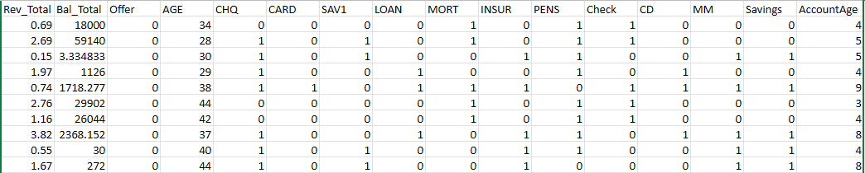
Data Snapshot
For additional clarity, here is a sample of our data to get a sense of its format:

Slide 4
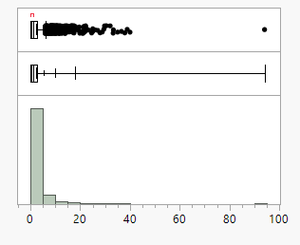
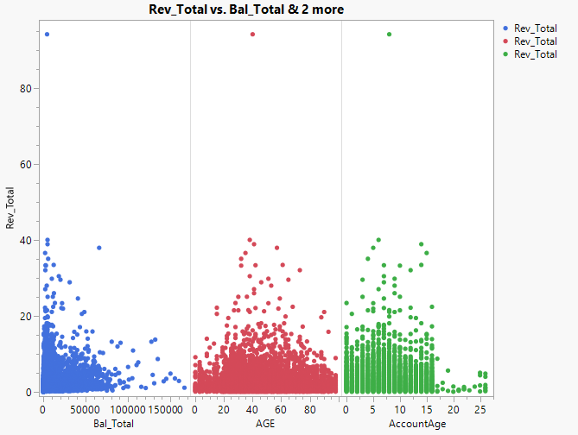
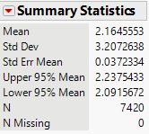
Exploratory Data Analysis
Rev_Total Distribution
Rev_Total vs. Quantitative Variables
Rev_Total has a Median of $1.17

Slide 5

Model 1
Our first proposed model was designed to gain broad insights into the data and to keep it simple, we included only the quantitative variables
$E\left(y\right)= β_{0}+ β_{1}x_{1}+ β_{2}x_{2}+ β_{3}x_{3}$
Where:
$x_{1}=Balance Total$
$x_{2}=Customer Age$
$x_{3}=Account Age$
Hypothesis:
$H_{0}: β_{1}=β_{2}= β_{3}=0 vs. H_{1}:at least one β_{i}≠0$
Due to the distribution of our data, we don’t expect this model to perform well, but we need a baseline from which to remove any influential outliers and assess what the next step should be

Slide 6
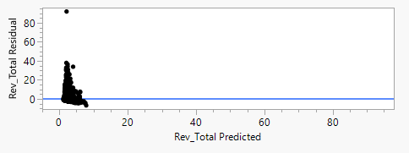
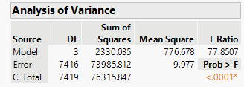
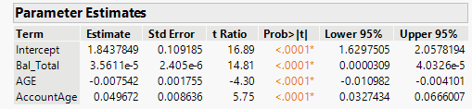
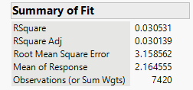
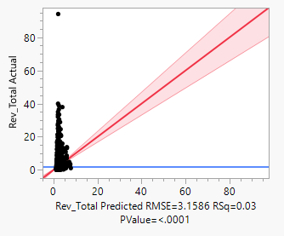
Model 1 Results
With a P-value of < 0.0001 we would reject the null hypothesis; the model is statistically significant at predicting revenue
Based on our Adjusted R² value, the model only accounts for 3% of the variance.

Slide 7
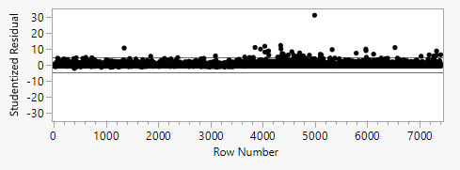
Removing Outliers
Looking at Cook’s Distance values no outliers were greater than 1.0
Plotting External Studentized Residuals showed more outliers that had probable influence
120 rows of outliers were removed leaving 7,300 rows of data
Re-running Model 1 yielded an Adjusted R² value of 0.06

Slide 8
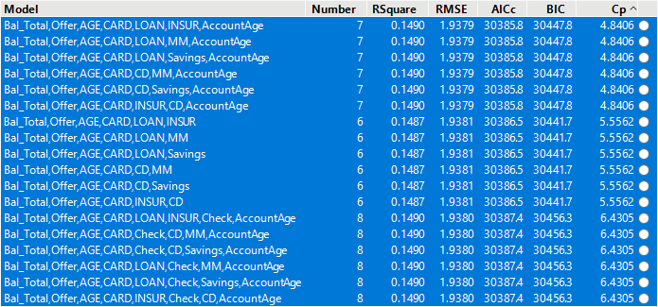
Determining Crucial Variables
Using Stepwise and starting with all possible models
Consistently chose: Bal_Total, Age, AccountAge, Offer, Card, and LOAN (last variable varies)
Tested Forward, Backward and Mixed Step
Each of these chose: Bal_Total, AGE, Offer, CARD, LOAN, and INSUR

Slide 9
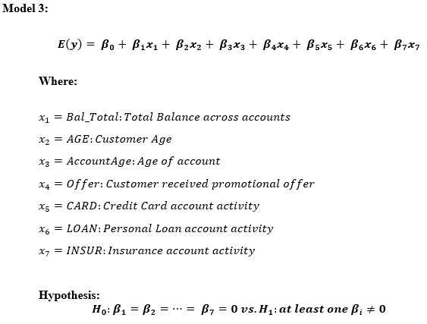
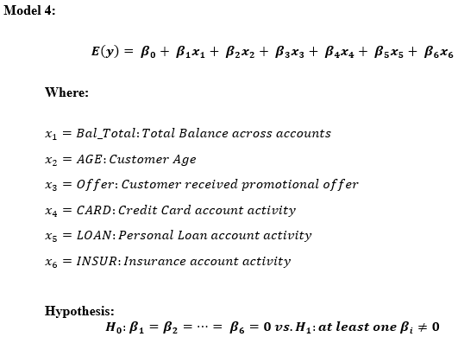
Comparing the Two Models

Slide 10
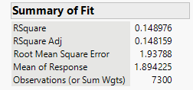
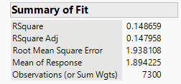
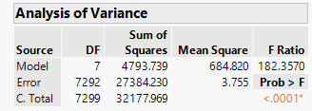
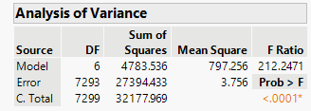
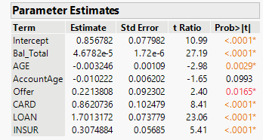
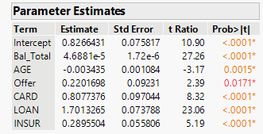
Comparing the Two Models
Model 3
Model 4

Slide 11
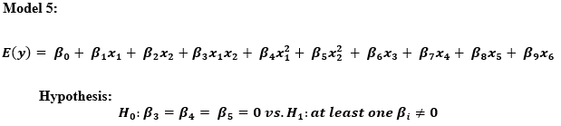
Improving on Model 4
While Model 4 was a considerable improvement over the previous models we want to continue building off of this model to try and improve the Adjusted R² value.
We proposed Model 5 which includes interactions and second-order terms for the quantitative variables, shown below:

Slide 12
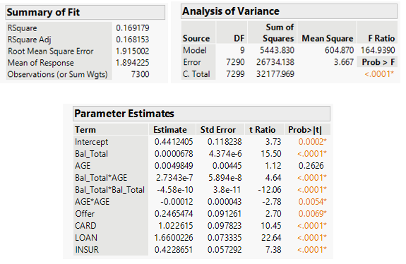
Model 5 Results
P-value < 0.0001; We would reject the null hypothesis
Improved Adjusted R²
Low MSE
All variables except AGE have low P-values

Slide 13
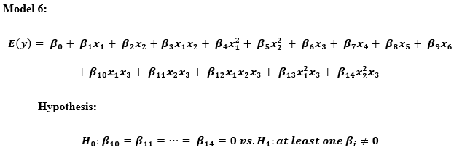
Final Proposed Model
Model 6
Builds off of Model 5
Includes interactions with “Offer” variable

Slide 14
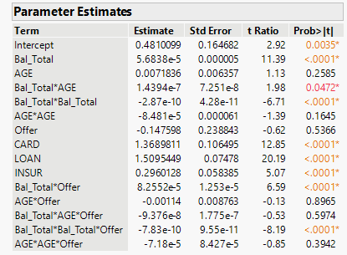
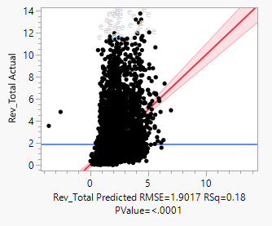
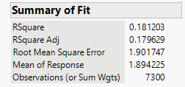
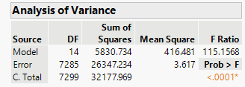
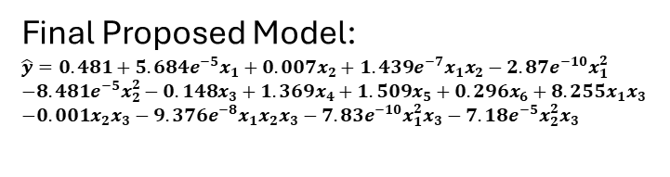
Model 6 Results
Reject the null hypothesis
Improved Adjusted R²
Lowest MSE of all models
Closer fit on the plot
Final Proposed Model:
$$\hat{y}=0.481+5.684e^{−5}x_{1}+0.007x_{2}+1.439e^{−7}x_{1}x_{2}−2.87e^{−10}x_{1}^{2}$$
$$−8.481e^{−5}x_{2}^{2}−0.148x_{3}+1.369x_{4}+1.509x_{5}+0.296x_{6}+8.255x_{1}x_{3}$$
$$−0.001x_{2}x_{3}−9.376e^{−8}x_{1}x_{2}x_{3}−7.83e^{−10}x_{1}^{2}x_{3}−7.18e^{−5}x_{2}^{2}x_{3}$$

Slide 15
Conclusion
Difficulty with the distribution of data
Variables with most positive influence on Revenue: Credit Card accounts, Personal Loan accounts, and Insurance accounts
Data may be more effective if each account was a quantitative variable of the balance
Very little revenue generated per customer, only $1.17 median
Model may be further improved with different or additional interactions included

